Slide 1
Evaluation Report
Audio Melody Extraction
Music Information Retrieval Evaluation eXchange (MIREX)
Enmao Diao
Georgia Institute of Technology
diaoenmao@gmail.com

Slide 2
Overview
Result Evaluation
Approaches Evaluation
Evaluation Metrics
Dataset Introduction
Time Analysis
Data Analysis
Well Performing Submission Evaluation
Possible Solution

Slide 3
Evaluation Metrics
 |  | Detected as |  | Sum
 |  | Unvoiced | Voiced
Ground Truth | Unvoiced | TN | FP | GU
 | Voiced | FN | TP | GV
Sum |  | DU | DV | TO
TN: Truth Negative, FN: False Negative, FP: False Positive, TP: Truth Positive, DU: Detected as Unvoiced, DV: Detected as Voiced, GU: Ground Truth Unvoiced, GV: Ground Truth Voiced, TO: Total, C: correctly labeled pitch, I: incorrectly labeled pitch, ch: chroma

Slide 4
Evaluation Metrics
Pitch Identification Metrics
Overall Accuracy: A measurement that combines both the voicing detection and the pitch detection. It gives the
proportion of time frames that were correctly labeled with both pitch and voicing.
RPA: The probability of a correct pitch value (to within ± ¼ tone) in each frame is estimated within all the time frames.
This includes the pitch guesses for frames that were judged unvoiced.
RCA: The probability that the chroma (i.e. the note name) is correct over the voiced frames. This ignores errors where the pitch is wrong by an exact multiple of an octave (octave errors). Thus, this value is often greater than RPA.

Slide 5
Evaluation Metrics
Voice Detection Metrics
Voicing Detection Rate: The probability that a frame which is truly voiced is labeled as voiced.
Voicing False Alarm Rate: The probability that a frame which is not actually voiced is none the less labeled as voice.
Voicing d-prime d’: is a measure of the sensitivity of detecting to factor out the overall bias towards labeling any frame as voiced (which can move both hit rate and false alarm rate up and down in tandem). It converts the hit rate and false alarm into standard deviations away from the mean of an equivalent Gaussian distribution, and reports the difference between them. A larger value indicates a detection scheme with better discrimination between Voicing Detection Rate and Voicing False Alarm Rate.

Slide 6
Dataset Introduction
ADC04 database: Dataset from the 2004 Audio Description Contest. 20 excerpts of about 20s each.
MIREX05 database: 25 phrase excerpts of 10-40 sec from the following genres: Rock, R&B, Pop, Jazz, Solo classical piano.
MIREX08 database: 4 excerpts of 1 min. from "north Indian classical vocal performances", instruments: singing voice (male, female), tanpura (Indian instrument, perpetual background drone), harmonium (secondary melodic instrument) and tablas (pitched percussions). There are two different mixtures of each of the 4 excerpts with differing amounts of accompaniment for a total of 8 audio clips.
MIREX09 database: 374 Karaoke recordings of Chinese songs. Each recording is mixed at three different levels of Signal-to-Accompaniment Ratio {-5dB, 0dB, +5 dB} for a total of 1122 audio clips. Instruments: singing voice (male, female), synthetic accompaniment. The Ground Truth pitch of each clip is human labeled, with a frame size of 40ms, a hop size of 20 ms. Note that the center of the first frame is located at 20ms starting from the very beginning of a clip. The human labeled pitch is then interpolated to have a hop size of 10ms. Thus the time sequence of the pitch vector are 20ms, 30ms, 40ms, 50ms, and so on.

Slide 7
Result Evaluation
Statistical data retrieved from official website
Data Analysis
Time Analysis
Time Analysis
Statistical Analysis for all datasets on the basis of the same metrics from 2009 through 2014
Data Analysis
Statistical Analysis for each dataset on the basis of different metrics from 2009 through 2014

Slide 8
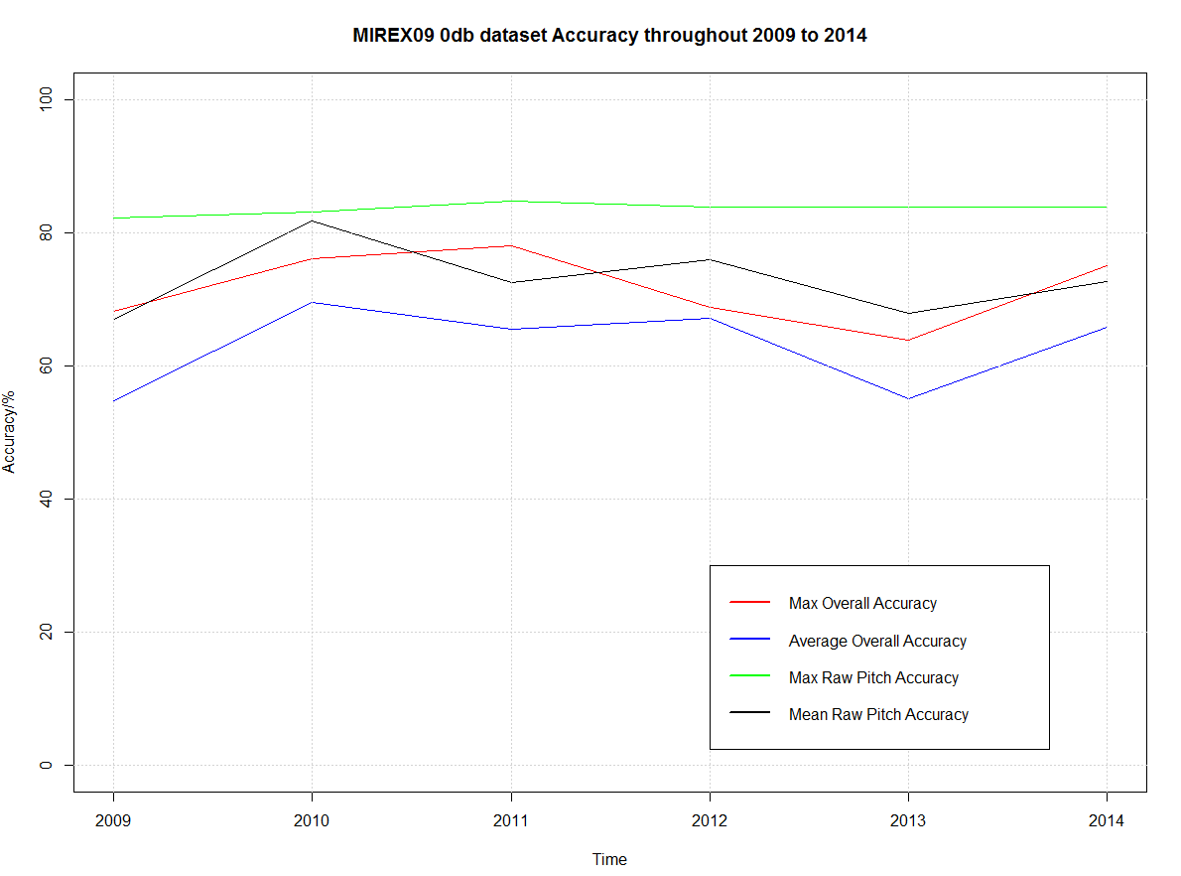
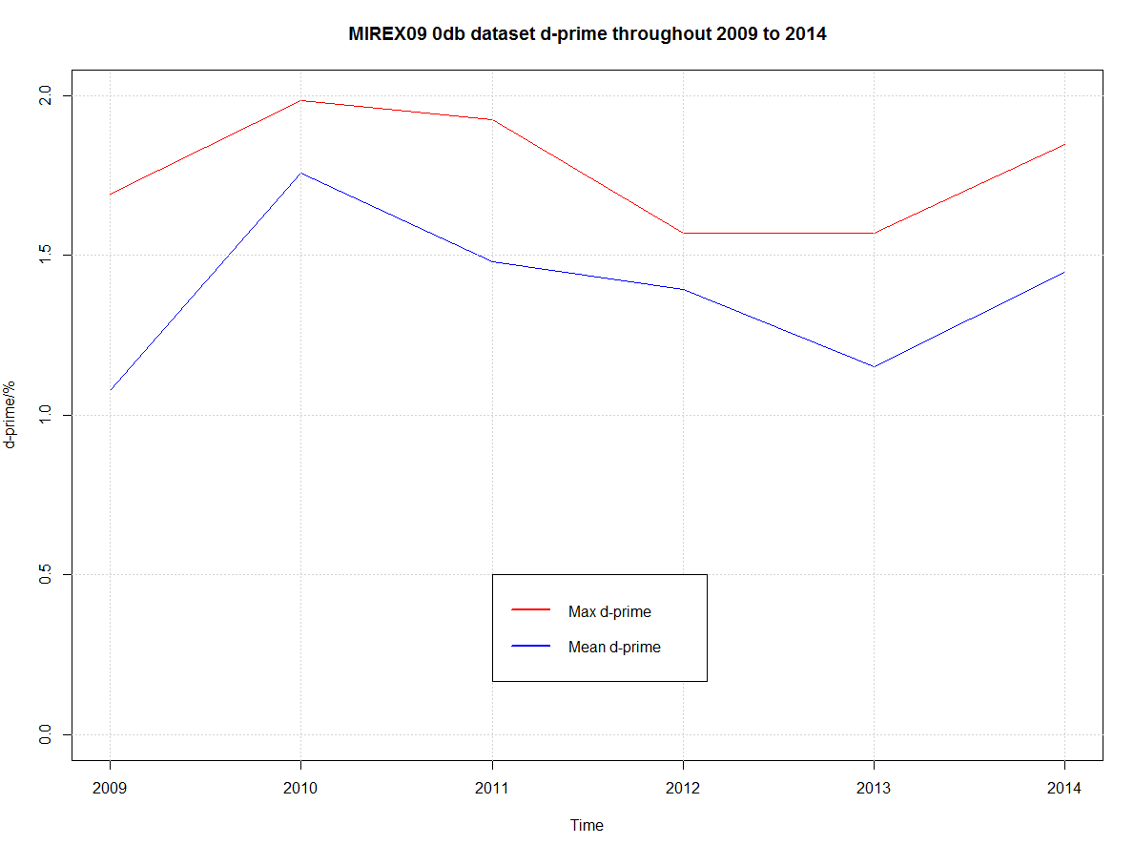
Time Analysis
From 2009 through 2014, we do not achieve a significant breakthrough.

Slide 9
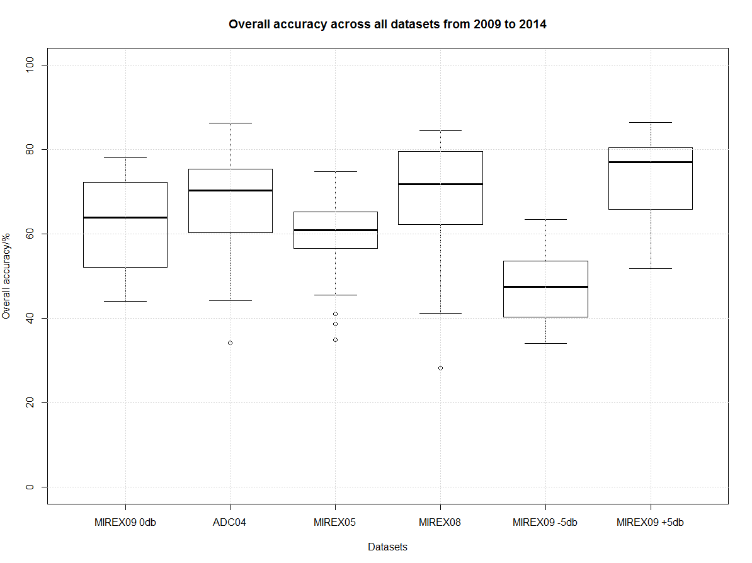
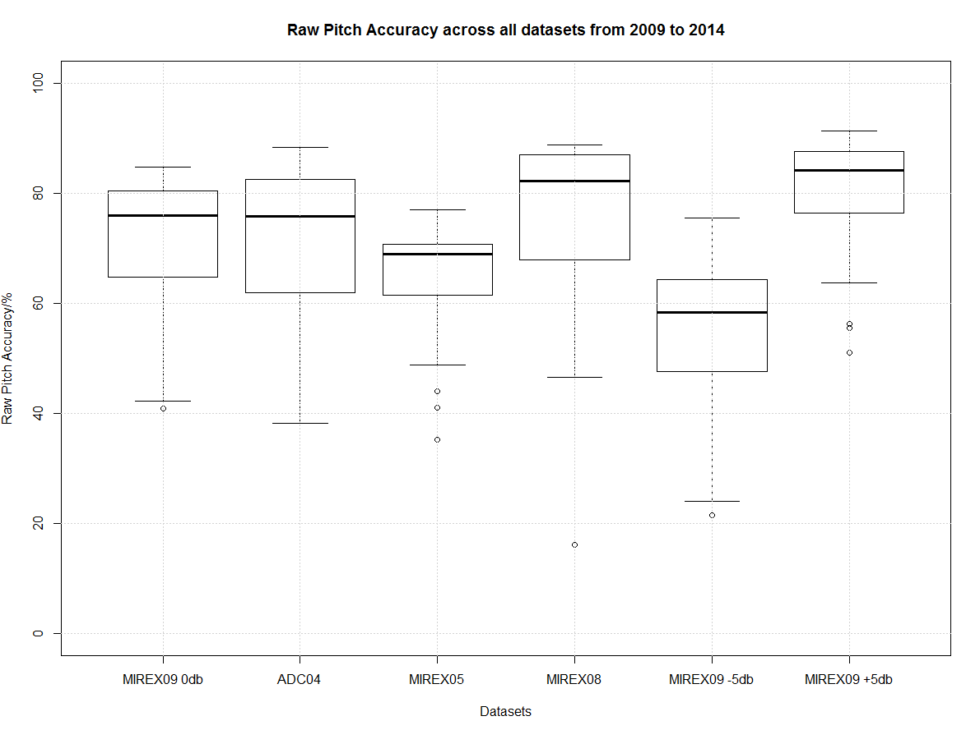
Data Analysis
MIREX09 is the least biased considering the large number of audio clips.

Slide 10
Best Performing Submission
Dataset | Max Overall Accuracy | Max Overall Accuracy Author | Max Raw Pitch Accuracy | Max Raw Pitch Accuracy Author | Best Voicing Detection Rate(d-prime) | Best Voicing Detection Rate Author
MIREX09 | 78.07% | Salamon | 84.71% | Salamon | 1.986 | Hsu
ADC04 | 86.30% | Dressler | 88.36% | Dressler | 2.385 | Dressler
MIREX05 | 74.84% | Dressler | 77.03% | Dressler | 1.584 | Dressler
MIREX08 | 84.44% | Salamon | 88.85% | Salamon | 2.251 | Salamon
MIREX09 -5db | 63.49% | Tachibana | 75.49% | Tachibana | 1.483 | Hsu
MIREX09 +5db | 86.38% | Doreso | 91.39% | Salamon, | 2.605 | Doreso¹
^{[1]} A company

Slide 11
Approaches
Multi-pitch Extraction |  | Pitch Identification |  | Window Length |  | Voice Detection
STFT | 10 | Salience function | 2 | Variable | 5 | MFCC | 5
(M)HPSS | 2 | (N)SHS | 1 | Fixed | 3 | Salience function | 2
MR-FFT | 4 | HMM | 2 |  |  | HMM | 1
Q-transform | 1 | Gaussian function | 2 |  |  | Mahalanobis distance | 1
 |  | Timbre model | 1 |  |  | NHE | 1
 |  |  |  |  |  | Power estimation | 1
Total | 17 |  | 9 |  | 8 |  | 11
More Info

Slide 12

Q&A ?

